Slide 1
GLOBAL
DATA SCIENCE
SALARY
COMPARISON
PRESENTED BY
SOLAI VASUKI G

Slide 2
PROJECT OBJECTIVE
Analyze and compare data science salaries globally.
1
Understand the impact of country, experience level, and company size on salaries.
2
Help job seekers and HR professionals with insights for decision-making.
3

Slide 3

PROBLEM STATEMENT
Lack of Salary Transparency
Geographical Salary Gaps
Impact of Experience and Role
Influence of Company Size & Type
Need for Data-Driven Insights

Slide 4

DATA SOURCES
Work Year
Job Title
Experience Level
Employment Type
Company Size
Company Location
Salary in USD
Remote Work Ratio
Education level
Includes fields such as:
PRIMARY DATA SOURCE :
Primary data source taken from Kaggle, and also for further analysis taken data's from https://aijobs.net/salaries/ .

Slide 5
DATA MODEL
Structured as a single fact table with necessary dimensions.
No complex relationships — direct analysis from a clean dataset.
Added calculated columns and DAX measures for:
Average Salary
Maximum Salary
Minimum Salary
Salary Growth by Experience
Salary Comparison by Company Size

Slide 6

DATA PREPROCESS
Removed null values and duplicates.
Standardized country and job titles.
Filtered out salary for better accuracy.
Created new calculated columns:
Experience Category (Junior, Mid, Senior)
Company size (Small, Mid, Big)
Employment Types(Full time , remote, contract)
Salary in USD

Slide 7
VISUALIZATIONS
Bar Charts: Salary comparison by country.
Line Charts: Salary trends over experience levels.
Cards/KPIs: Highest and lowest salary.
Slicers: Country, Experience Level, Company Size, Remote Work.
Maps: (Optional) Average Salary by World Map.

Slide 8
Special Features Implemented
Interactive Slicers for user-driven filtering.
Dynamic KPIs to display key metrics.
Drill-through pages for detailed country-wise
analysis.
Tooltips showing extra info on hover.
Bookmarks for easy navigation (optional).

Slide 9
INSIGHTS GENERATED
US and Switzerland reported highest average salaries.
Entry-level salaries vary by 40-60% between countries.
Remote work offers comparable salaries across different regions.
Larger companies tend to offer higher salaries than startups.

Slide 10
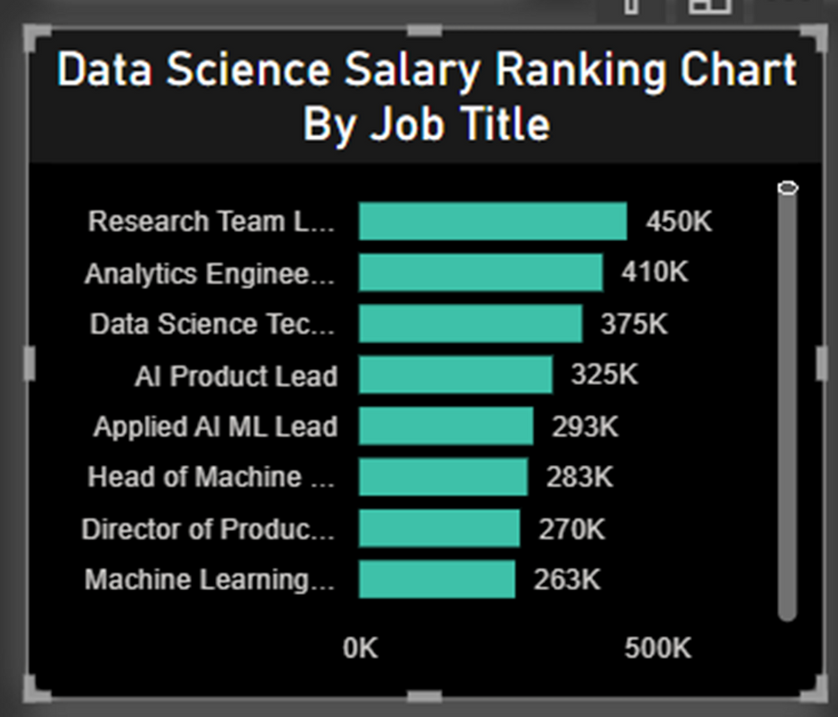
JOB DESCRIPTION-WISE SALARY INSIGHTS
This section analyzes how salaries vary across different job roles by examining job descriptions, highlighting high-paying positions, the impact of skills and experience, and industry-specific salary trends to provide insights for job seekers and employers.

Slide 11
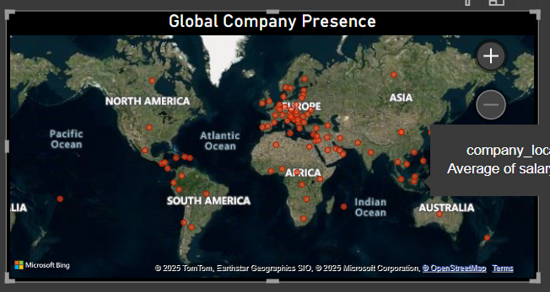
GLOBAL PRESENCE OF THE COMPANY
The map illustrates which regions have the highest number of data science-related jobs.

Slide 12
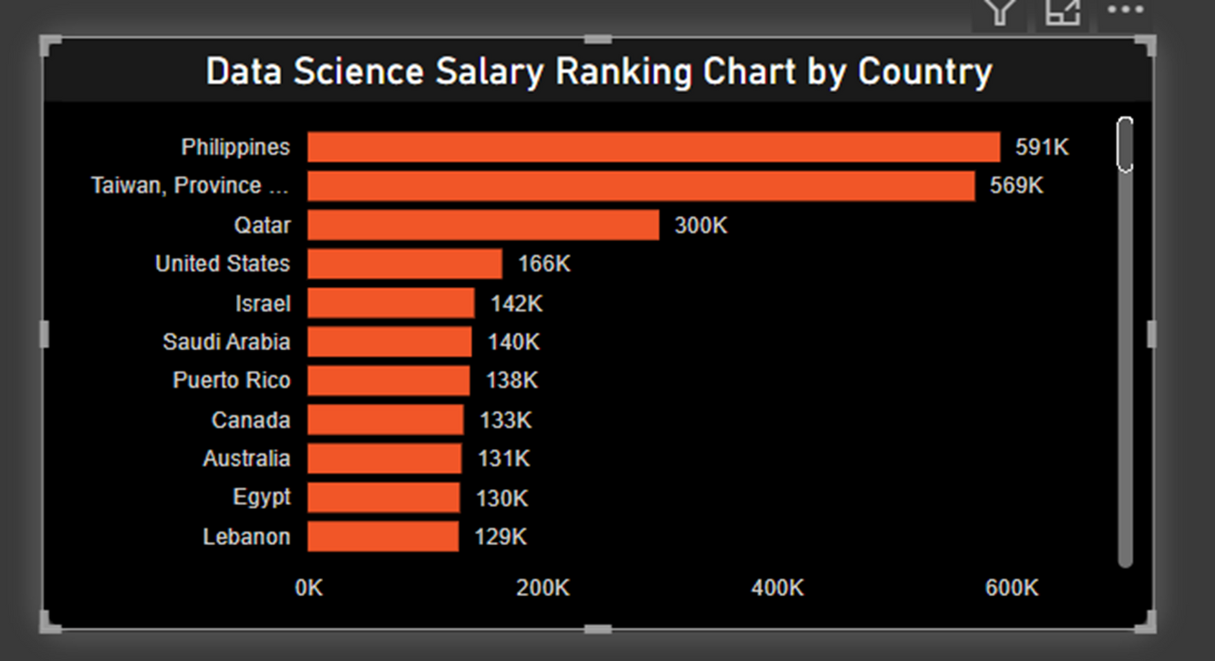
TOP COUNTRIES FOR DATA SCIENCE SALARIES
This chart ranks countries based on the average salaries of data science professionals.
It highlights the top-paying nations, helping users compare compensation across global markets.

Slide 13
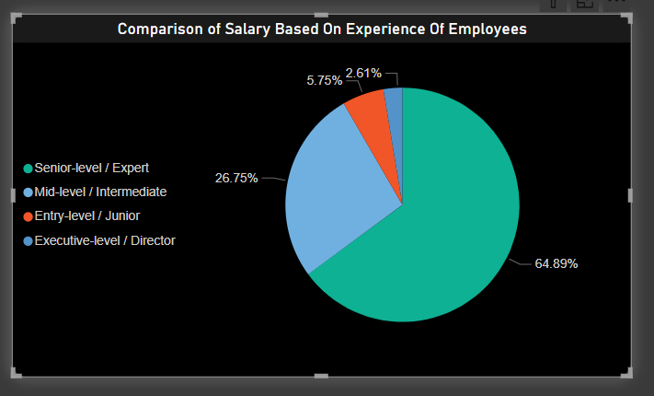
SALARY COMPARISON BY EXPERIENCE LEVEL
This analysis compares data science salaries across different experience levels, from entry-level to senior professionals.

Slide 14
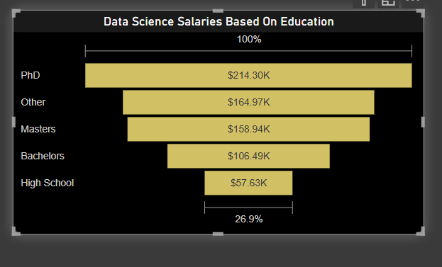
DATA SCIENCE SALARY TRENDS BASED ON EDUCATION
This analysis examines how educational qualifications influence data science salaries.
It highlights salary differences between professionals with bachelor’s, master’s, and specialized degrees or certifications.

Slide 15
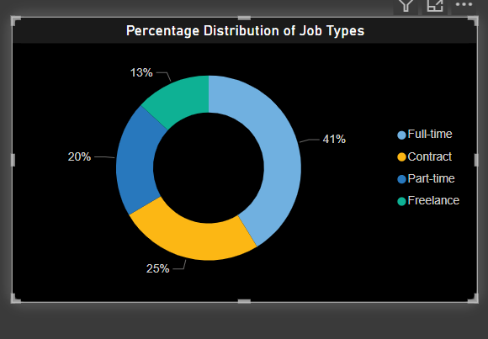
DISTRIBUTION OF DATA SCIENCE JOB TYPES BY EMPLOYMENT MODE
This chart presents the percentage distribution of various job types in the data science field, including full-time, remote, contract, and part-time positions.
It provides insights into current employment trends and the growing popularity of flexible work arrangements.

Slide 16
CONCLUSION
Data science continues to be one of the most in-demand and well-paid career paths globally.
Salary is influenced by multiple factors such as job role, experience level, location, company size, and work mode.
U.S. and Western Europe dominate in high compensation, but remote opportunities are closing the gap for global talent.
Senior-level roles and specialized skills like ML and AI command significantly higher pay.
This analysis helps professionals plan career moves wisely and companies benchmark salaries competitively.
A data-driven approach to compensation is key to attracting and retaining top talent in data science.

Slide 17
Q&A
SESSION

Slide 18

Thank you

